Slide 1
An Overview of Systematic Reviews
Calum MacGillivray, PhD Student (Education), University of Dundee
c.y.macgillivray@dundee.ac.uk | University Profile | ORCiD

Slide 2
Housekeeping
Timings: planned conservatively – we may finish early!
Breaks: a short break every hour and an hour for lunch
Questions: there will be time for questions - but jump in whenever
Afterwards: feel free to email me with any questions
Resources for this workshop can be found here: https://calummacgillivray.github.io/Training/

Slide 3
Plan for Today
10:00 – 10:45
Introductions and Background
11:00 – 11:45
Methodology
12:00 – 13:00
Designing a Search Strategy
13:00 – 14:00
Lunch
14:00 – 14:45
Screening
15:00 – 15:45
Coding and Critical Appraisal
16:00 – 17:00
Discussing Synthesis and Dissemination

Slide 4
Session 1: Introductions and Background

Slide 5
Introductions
Who am I?
Name: Calum MacGillivray
University: University of Dundee, School of Humanities, Social Science and Law
Discipline: Education (with a developmental psychology background)
PhD Project: Primary-secondary transitions experiences and associated educational outcomes
Experience with systematic reviews: Have read plenty! Have conducted systematic reviews with meta-analysis, narrative synthesis as well as a review of reviews.
Now who are you?
What’s your name? | Your discipline/background? | What are you working on? | Do you have any experience with systematic reviews?

Slide 6
What do you know already?
What is a systematic review?
Why might you conduct a systematic review?
Are you aware of any methods for conducting systematic reviews?
What do you hope to get out of today?

Slide 7
Learning Outcomes
Feel more confident in reading, interpreting and conducting systematic reviews by:
Learning how to conduct high quality systematic reviews
Building knowledge of various methods and tools available to support the process
Gaining practical skills in building a search, screening, coding and quality appraisal
Being aware of different methods of synthesising findings

Slide 8
A Note on Terminology
Literature Review
Systematic Review
Rapid Review
Review of Reviews/Umbrella Review
Mapping review
Scoping Review
Meta-synthesis
Meta analysis
Narrative synthesis
Grant, M. J., & Booth, A. (2009). A typology of reviews: An analysis of 14 review types and associated methodologies. Health Information & Libraries Journal, 26(2), 91–108. https://doi.org/10.1111/j.1471-1842.2009.00848.x

Slide 9
Systematic Reviews
Aim to use systematic methods to search, appraise and synthesise evidence from research findings.
Systematically gathering sources and formally evaluating them can help to address the increased subjectivity involved in other literature reviews.
The usefulness of a systematic review is related to how transparent and therefore replicable the methods are.
Relevant References: Grant & Booth, (2009); Hodgkinson and Ford, (2014); Linnenluecke et al., (2020); Page et al., (2021)

Slide 10
An Anatomy of a Systematic review
Designing the Review
Research Questions
Methodology
Searching
Databases
Journals
Screening
Titles
Abstracts
Protocol
Search Strategy
Scoping
Grey Literature
Citation Searching
Websites
Emails
Full texts
(Dis)agreement
Data Extraction
The Team
Coding
Critical Appraisal (Risk of Bias)
Analysis/Meta-synthesis
Narrative Synthesis
Meta Analysis

Slide 11
A brief (and incomplete) history
1975: Meta-Analysis (psychotherapy)
Archie Cochrane: evidence based medicine
Cochrane Systematic Reviews: health care intervention efficacy
Cambell Collaboration: public policy scope
EPPI Centre: education and welfare
QUOROM, then PRISMA: reporting guidelines
https://eppi.ioe.ac.uk/cms/Resources/EvidenceInformedPolicyandPractice/HistoryofSystematicReviews/tabid/68/Default.aspx

Slide 12
PRISMA Flow Diagram
Transparent Method of Reporting
Records identified
Records excluded at each stage
Reasons for exclusion
Studies finally included
https://www.prisma-statement.org/prisma-2020-flow-diagram

Slide 13
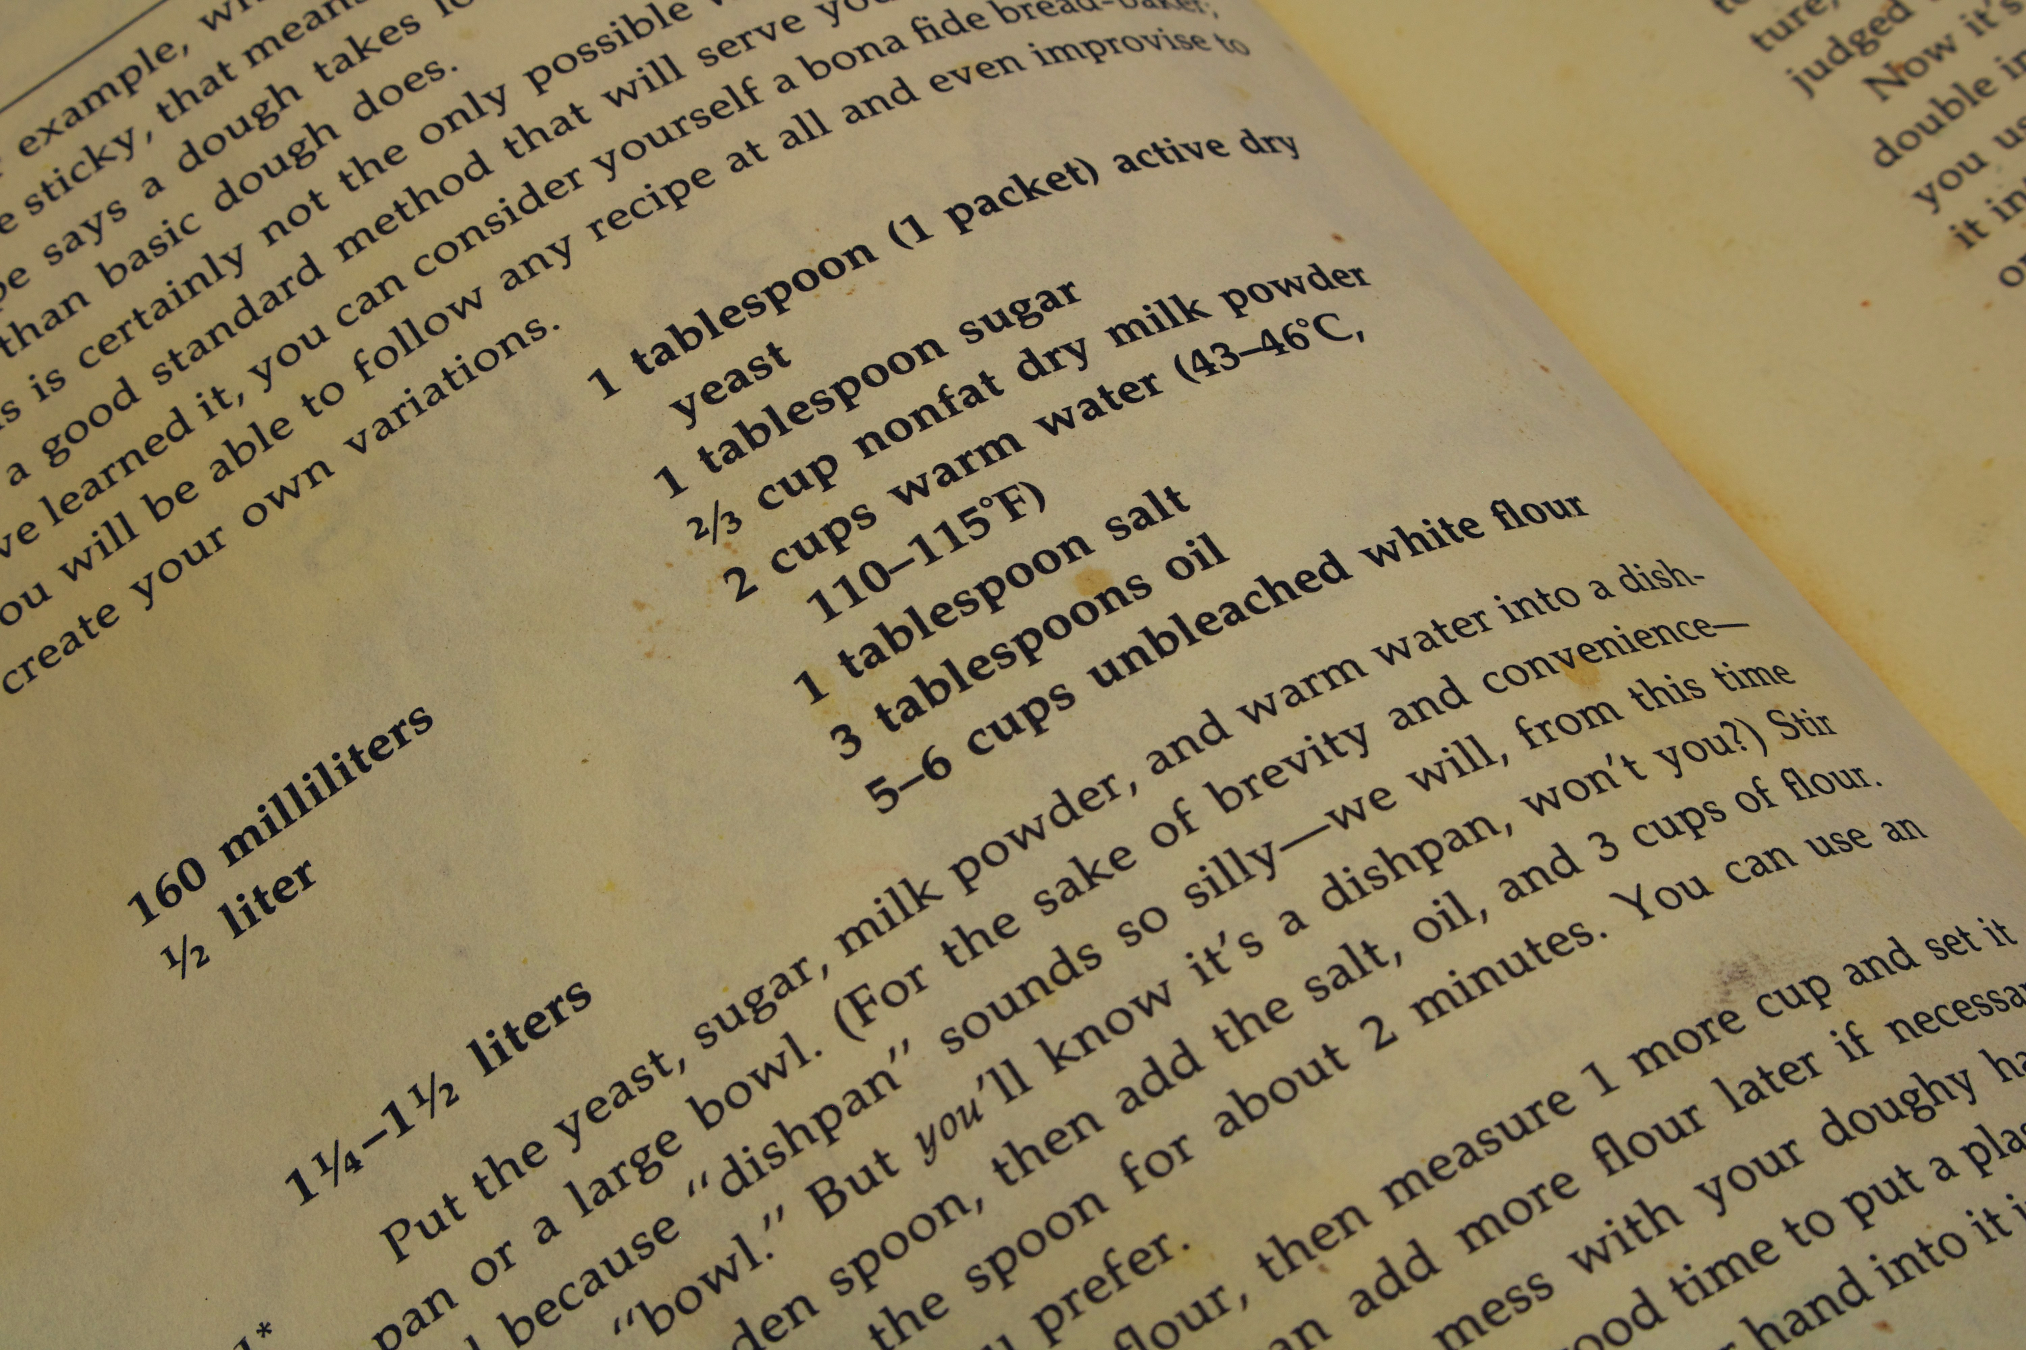
Why conduct a systematic review?
Following the ‘recipe.’
A structured approach
Reproducible (when transparent)
Reduce subjectivity – although not always the goal
Get a good view of the available literature
Find gaps
Assess the quality of methodology
Assess the strength of evidence across the literature
Photo by James Lee on Unsplash

Slide 14
Addressing the Replication Crisis
2011 – a bad year for psychology
Precognition – dubiously published
Diedrik Stapel – fabricating data
Using common methods to argue that listening to a song could reduce a participants age – to prove a point
The name-letter effect – failed to replicate
Many studies suffer from large amounts of unrecognised bias
The result: “Crisis of Confidence”
But this is not limited to psychology
Dubious practice exists across scientific disciplines
Wiggins, B. J., & Christopherson, C. D. (2019). The replication crisis in psychology: An overview for theoretical and philosophical psychology. Journal of Theoretical and Philosophical Psychology, 39(4), 202–217. https://doi.org/10.1037/teo0000137
Pashler, H., & Wagenmakers, E. (2012). Editors’ Introduction to the Special Section on Replicability in Psychological Science: A Crisis of Confidence? Perspectives on Psychological Science, 7(6), 528-530. https://doi.org/10.1177/1745691612465253
Baker, M. (2016). 1,500 scientists lift the lid on reproducibility. Nature, 533, 452–454. https://doi.org/10.1038/533452a

Slide 15

Bias
Bias from incorrectly applied (or understood) methodology
Failure to address confounding factors
Faulty metrics
Participant selection
Missing data
Misinterpretation
Congruity between philosophical, theoretical, and methodological approach
Publication bias (the file drawer problem)
Photo by Drew Beamer on Unsplash

Slide 16
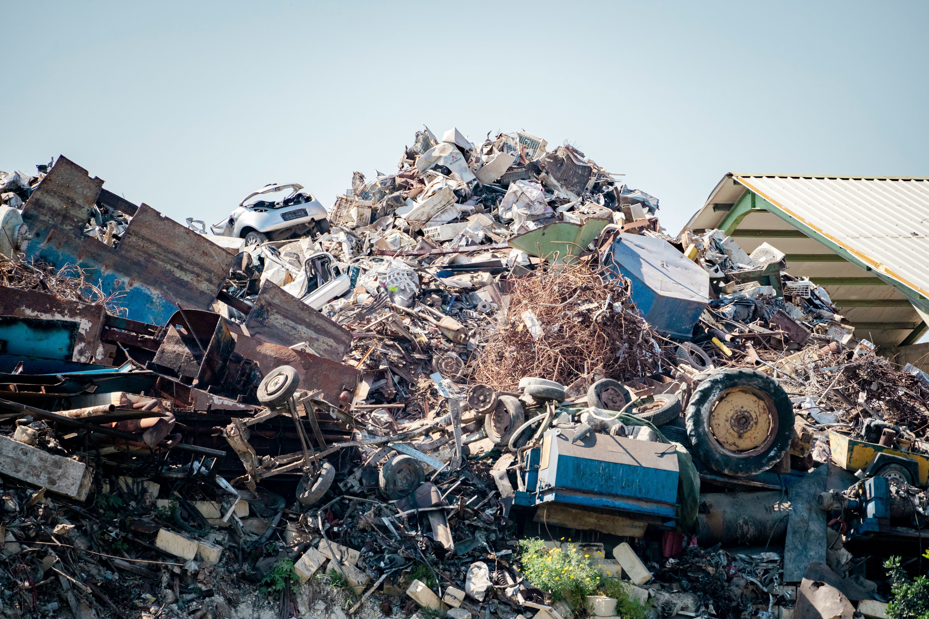
Addressing the Replication Crisis
Systematic reviews pre-date the replication crisis
Rubbish in > Rubbish out
But can begin to address the file drawer problem
Can also make informed decisions on what to include
Exclusion
Weighting
Can be a tool for systematic, rigorous critique
Can highlight the methodological shortcomings/strengths in the literature
Can assess risk of bias
Photo by Evan Demicoli on Unsplash

Slide 17
Identifying Gaps in the Literature
The aim: capture the majority of the literature on the research topic
related to inclusion/exclusion criteria
Overview – can see gaps for future studies
Weaknesses worth addressing
The place for replication studies
What methods are used?
Is there one dominant strand?
Is that telling the full story?

Slide 18
Assessing Interventions
A classic – with a basis in healthcare
But applicable to other fields
Gathering all known studies on an intervention
Assessing the quality of those studies
And risk of bias
Bringing together their findings (synthesis)
Potentially weighting or excluding some
Based on predefined criteria
But beware the file drawer problem!
Photo by Drew Beamer on Unsplash
Photo by Drew Beamer on Unsplash

Slide 19

Synthesis of the literature
Bringing together findings
Creating a new perspective
Can cover any methodology
Quantitative
Qualitative
Mixed Methods
Narrative Synthesis
Meta Analysis
Carefully consider what you are bringing together
Don’t accidentally equate apples with oranges!
Photo by Gowtham AGM on Unsplash

Slide 20
Building Evidence for Policy and Practice
The evidence is brought together
Then assessed
Then synthesised
Rigorously and systematically
This can provide credibility
Transparency/reproducibility helps with this
Can make policy/practice recommendations (when appropriate/congruous)
However, do consider the views of the people that are the topic of your review
Some reviews are codesigned
Many involve checking with those affected
This can be ongoing

Slide 21
A note on AI
Some researchers are now using AI tools for every step of the review.
There must be caution here.
A key strength of the systematic review comes from its transparency and replicability
AI can obfuscate these processes, especially when based on probability.
If you do use these methods you must be transparent about when and how you used them.
Be aware of the suitability and what is being lost.
Your judgement is an important tool.
Responsible AI in Evidence Synthesis (RAISE): guidance and recommendations: https://osf.io/fwaud/

Slide 22
Any questions?

Slide 23
10-15 minute break
Up Next: Methodology

Slide 24
Session 2: Methodology

Slide 25
Is anyone aware of any methods used in systematic reviews already?

Slide 26
The Anatomy of a Systematic review
Designing the Review
Research Questions
Methodology
Searching
Databases
Journals
Screening
Titles
Abstracts
Protocol
Search Strategy
Scoping
Grey Literature
Citation Searching
Websites
Emails
Full texts
(Dis)agreement
Data Extraction
The Team
Coding
Critical Appraisal (Risk of Bias)
Analysis/Meta-synthesis
Narrative Synthesis
Meta Analysis

Slide 27

Frameworks/approaches
Useful in guiding the development of the protocol
Methods often designed for specific purposes
Examples
Eppi-Centre
JBI
Campbell
Worth looking into several to make a decision on best fit
Don’t let the methodological tail wag the dog!
Approaches differ but most systematic reviews share some elements
Searching
Screening
Extraction
Appraisal
Synthesis
Photo by Kostiantyn Li on Unsplash

Slide 28
Protocols
Protocols are a useful way to enhance transparency
They also help you
Like a recipe you follow
This can help with planning/organisation
Protocols do not have to be restrictive
Rather they help to show when you changed an approach
It is important to communicate this – why?
It is helpful if there is a record of your protocol – aids transparency
Journals
Repositories – e.g. PROSPERO and OSF
Can be embargoed
Guidelines exist which can help – e.g. PRISMA-P
Photo by James Lee on Unsplash
https://www.prisma-statement.org/protocols

Slide 29
Designing the Review
It is usually helpful to design tools in advance
Can use specialist tools – will cover some later
Often simple spreadsheets will suffice to keep records
But design these mindfully
Will others be able to use these independently?
Comprehensive and precise record keeping is highly important
This is part of being transparent/replicable
Consider carefully your review questions
Then decide in advance what you will keep and what you will not
Inclusion/exclusion criteria

Slide 30
Searching
Choose multiple databases – one is rarely enough
There are studies on optimising this – but use your best judgement
E.g. Bramer et al., (2017)
From a medical perspective (recall percentage based on search using all databases)
Embase (85.9%), Embase and MEDLINE (92.8%), Embase, MEDLINE and Web of Science (95.9%), Embase, MEDLINE, Web of Science, and Google Scholar (98.3%).
But in specific circumstances PSYCINFO was important
Choose multiple databases to cover blindspots
Think about your specific topic
Be careful with search engines like google scholar as algorithms/obfuscation may make searches difficult to replicate
Targeted journal searching and citation searching can be useful
Bramer, W. M., Rethlefsen, M. L., Kleijnen, J., & Franco, O. H. (2017). Optimal database combinations for literature searches in systematic reviews: a prospective exploratory study. Systematic reviews, 6, 1-12. https://doi.org/10.1186/s13643-017-0644-y

Slide 31
Searching
Most reviews look at grey literature – at least to investigate the problem of publication bias
Grey literature databases
Websites
Contacting researchers
Registrations/protocols
Conference abstracts
Can also include grey literature in synthesis
Photo by Drew Beamer on Unsplash

Slide 32
Searching
Design your search strategy to maximise relevant records while minimising irrelevant records
This is tricky and can take some time to get right
Scoping searches
Iterative design
Eventually you will have your final search terms
We will discuss Boolean operators for search terms later
Keep record of numbers – to complete a PRISMA diagram
Referencing software is well suited to this task
Sub folders can be very helpful

Slide 33

Working with others
The process can be made more rigorous by ensuring no one researcher is solely responsible
Reduces risk of bias – from an individual
Ideally – 2 or more researchers undertake processes
Disputes are settled by another researcher
This can be done blindly
This can be limited by practical limitations – be transparent
This is helpful at various stages:
Screening
Coding
Appraisal

Slide 34
Screening
De-duplication often happens first
Software can help to flag potential duplicates – but be careful!
Can then screen by title/abstract
Sometimes just titles first, then abstracts
At this stage only records that are obviously not suitable is done
Erring on the conservative side
Then full texts are screened
Reasons are provided for exclusions at this stage
Referencing software can be used – tools like Covidence and Eppi-Reviewer also facilitate screening

Slide 35
Data Extraction
Data extraction usually uses predesigned coding spreadsheets
But tools like Covidence and Eppi-reviewer are designed for this too
Usually key information
E.g. bibliographic information, population information, sample size, research design, sampling, analysis methods, items relevant to research questions, etc.
Effect sizes, Standard errors, or information to calculate effect sizes if conducting meta-analysis

Slide 36
Critical Appraisal
Critical appraisal, quality appraisal, risk of bias assessment
Various methods are used to assess quality of included studies
Important to address rubbish in > rubbish out
Although poor quality research is a finding itself
Cut offs are often decided in advance – although judgement will be required
We will cover various tools later to do this
It is worth carefully considering which tool best suits your review
Sometimes there is a reason to include low quality research
E.g. you are interested in methods being used
But if findings are synthesised you may be placing equal weight on two unequal studies

Slide 37
Analysis/Synthesis
We will spend some time discussing analysis/synthesis at the end
This tends to take a qualitative approach, quantitative approach, or mixed methods approach
Evidence synthesis is the combination of information from across studies.
Meta-synthesis, narrative synthesis, meta-analysis, etc.

Slide 38
What Next?
Many studies check with the impacted population (or have codesigned the review from the start)
Patient and Public Involvement (PPI)
Participatory approaches
Realist reviews
Iterative negotiation
Consider how best to communicate findings to target audience

Slide 39
Any questions?

Slide 40
10-15 minute break
Up Next: Search Strategies

Slide 41
Session 3: Search Strategy

Slide 42
Considerations when designing a search strategy
Try to capture as many relevant records as possible, while minimising irrelevant records
Screening is a labour-intensive process
The less hits, the quicker it will be
But the more that could be potentially missed
PICOS
Population
Intervention
Comparison
Outcome
Study Design
SPIDER
Sample
Phenomenon of Interest
Design
Evaluation
Research type
Methley, A. M., Campbell, S., Chew-Graham, C., McNally, R., & Cheraghi-Sohi, S. (2014). PICO, PICOS and SPIDER: a comparison study of specificity and sensitivity in three search tools for qualitative systematic reviews. BMC health services research, 14, 579. https://doi.org/10.1186/s12913-014-0579-0

Slide 43
Search Strategy Group Task – Part 1
In groups of 4-5 – choose 1 person to keep notes
Pick a review topic: from the list on the website
Pick key terms: to maximise relevant results while minimising irrelevant results – consider PICOS or SPIDER etc.
Find relevant databases: some discipline specific suggestion can be found on the website to get you started
Discuss relevant journals & other places where you may find relevant results
Website address: https://calummacgillivray.github.io/Training/

Slide 44
Search Strategy Group Task – Part 2
Still in groups
Discuss how to combine your search terms with Boolean operators
Brackets can be used to group terms
Asterisks can be used for wildcards e.g. Mov* = move, moving, movers, movers, moved, etc.
Primary NOT Middle NOT Elementary | Primary AND Middle AND Elementary | Primary OR Middle OR Elementary
Primary
Primary
Primary
Middle
Elementary
Middle
Elementary
Middle
Elementary
Website address: https://calummacgillivray.github.io/Training/

Slide 45
Any questions?

Slide 46
Lunch Up Next: Screening

Slide 47
Session 4: Screening

Slide 48
Considerations For Screening
Screening is often done with titles and abstracts together
In this case we will look at each level individually
Screening is usually done with 2 or more screeners
They look individually and then disagreements are resolved by another
This can be blinded
The goal is to reduce the risk of bias from one screener
Spreadsheets are handy for keeping track of this process
Other tools available include, but are not limited to:
Covidence
Eppi-reviewer
And reference management software
Keep meticulous notes!

Slide 49
PRISMA Flow Diagram
Transparent Method of Reporting
Records identified
Records excluded at each stage
Reasons for exclusion
Studies finally included
https://www.prisma-statement.org/prisma-2020-flow-diagram

Slide 50
Screening Task – Part 1, Titles
Individually
From the website – download the documents called Titles and Search Criteria
Based on this remove duplicates
Then decide which are irrelevant to the search criteria
Consider:
What is easy to remove?
What are you unsure about?
Compare your decisions with others in your group
Do you all agree?
What do you disagree with, and why?
Website address: https://calummacgillivray.github.io/Training/

Slide 51
Screening Task – Part 2, Abstracts
Individually
From the website – download the documents called Abstracts and Search Criteria
Decide which are irrelevant to the search criteria
Consider:
What is easy to remove?
What are you unsure about?
Was there anything that could have been removed previously?
Website address: https://calummacgillivray.github.io/Training/

Slide 52
Screening Task – Part 3, Full Texts
Individually
From the website – download the documents called Full Texts and Search Criteria
Then decide which are irrelevant to the search criteria
Consider:
What is easy to remove?
What are you unsure about?
How much longer does this stage take?
Was there anything that could have been removed before?
Website address: https://calummacgillivray.github.io/Training/

Slide 53
Any questions?

Slide 54
10-15 minute break
Up Next: Coding and Critical Appraisal

Slide 55
Section 5: Coding and Critical Appraisal

Slide 56
Considerations for Data Extraction
Data extraction can be done via spreadsheet or specialist tools.
E.g. Covidence; EPPI-Reviewer; JBI Sumari
This is where you procedurally extract the information of interest from each study – to form the basis of synthesis.
That is not to divorce that information from context
But provides a basis from which to build on
This can be done with multiple reviewers and cross-checking as in other stages
Consider carefully what you will capture here
If conducting meta-analysis, consider what happens when information you want is not available

Slide 57
Coding task
Individually
From the website, find the coding sheet
Use the 3 full texts from session 4
Try and fill it in as best you can
Consider
Is it capturing everything? What is lost?
What is easy to find?
What is hard to find?
Do you agree with others in your group with how to go about this?
Website address: https://calummacgillivray.github.io/Training/

Slide 58
Considerations for Critical Appraisal
Critical appraisal involves evaluating the strengths and weaknesses of studies
Often this is about considering the risk of bias
Here it is very useful to use a predesigned tool
Some tools are made for different purposes
We will all try to achieve the same task with a different tool to find the best fit
This is often done by more than one reviewer
Decisions can be made to exclude studies based on this

Slide 59
Critical Appraisal Group Task
In groups
You will each take a different critical appraisal tool
Follow the links online
Choose one person to fill in the form
Get it in an editable state
Consider
What do you agree/disagree on?
What about the tool works well?
Is the tool suitable for this task?
We will all use this paper: https://doi.org/10.1016/j.lindif.2020.101854
https://calummacgillivray.github.io/Training/

Slide 60
Any questions?

Slide 61
10-15 minute break
Up Next: Synthesis and Dissemination

Slide 62
Section 6: Synthesis and Dissemination

Slide 63
Types of synthesis
Meta-synthesis
Quantitative Synthesis
Meta Analysis
Qualitative Synthesis
Meta-aggregation
Narrative Synthesis
Mixed Methods (e.g. JBI Mixed Method Systematic Reviews)
Sequential – one after the other
Convergent - together
Integrated – quantitative and qualitative
Data is transformed – usually quant is qualitised
E.g. quantities could become declarative statements
It is more difficult the other way!
These are then synthesised in groups to address the review questions
Segregated – different parts of a wider topic
Separate qualitative and quantitative synthesis is conducted where possible
Then strands are compared and brought together
https://jbi-global-wiki.refined.site/space/MANUAL/355829259/8.3+The+JBI+approach+to+mixed+method+systematic+reviews

Slide 64

Qualitative Synthesis
Meta-aggregation
Specifically qualitative studies
Extracted findings are analytical statements
The plausibility is assessed
Findings are grouped – creating categories
Categories are grouped into synthesised findings
Narrative Synthesis
Qualitative or quantitative studies
Summarising, and grouping findings in a narrative way
Often enhanced by use of tabular data
Drawing out themes and patterns
Can be the planned synthesis
Can also be an option when planned meta-analysis is no longer feasible
Other options
Meta-ethnography
Realist synthesis
Critical interpretive synthesis
Qualitative research synthesis: methodological guidance for systematic reviewers utilizing meta-aggregation: http://doi.org/10.1097/XEB.0000000000000062

Slide 65
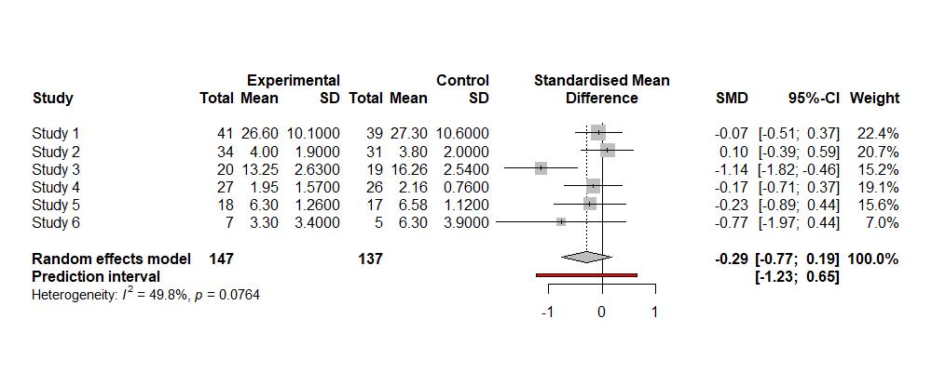
Meta Analysis
Random effects or fixed effects
Fixed effects – assume a common underlying effect (higher homogeneity)
Random effects – assume similar but different effects, drawn from a distribution (higher heterogeneity)
Assessing heterogeneity
Chi² (for independent groups) or Cochran’s Q (repeated measures with binary outcomes)
to detect heterogeneity – on significant p-value test
Higgins and Thompson’s I² – to quantify heterogeneity
Tau-squared – forms the basis of random effects analyses
Effect sizes
Pooling effect sizes
Publication bias
Other options:
Meta-regression Multilevel, SEM, Network, Bayesian
https://bookdown.org/MathiasHarrer/Doing_Meta_Analysis_in_R/

Slide 66
A little more on heterogeneity
According to the Cochrane handbook:
Chi² is prone to bias at small study numbers, or sample sizes
Therefore a non-significant finding does not mean hetergoeniety can be ruled out
At the extreme end – high numbers of studies can lead to unimportant heterogeneity being detected
0.1 (rather than 0.05) is often used as the threshold for this test
For I²
0% - 40%: possibly less important
30% - 60%: possibly moderate
50% - 90%: possibly substantial
75% - 100%: possibly considerable
https://www.cochrane.org/authors/handbooks-and-manuals/handbook/current/chapter-10

Slide 67
Forest Plots – Example Data
Simulating 6 studies comparing an outcome at T2 after an intervention for an experimental group vs a control group

Slide 68
Forest Plots – Measures

Slide 69
Forest Plots – Totals

Slide 70
Forest Plots – Means and Standard Deviations

Slide 71
Forest Plots – Standardised Mean Difference

Slide 72
Forest Plots – Confidence Intervals

Slide 73
Forest Plots – Weighting

Slide 74
Forest Plots – Pooled Statistics

Slide 75
Forest Plots – Interpreting the Plot
Line of null effect

Slide 76
Funnel Plots
Larger studies are more likely to be published - More resources are used
Sample size is related to standard error – higher sample leads to narrower SE and wider confidence intervals
Smaller studies less likely to find a significant finding
Non-significant studies are less likely to be published
Funnel Plots – more studies is better
Plotting effect sizes by Standardised mean difference and standard error
An exemplar expected funnel-shape in dotted lines
A middle line showing the average effect size
A symmetrical plot suggests publication bias is less likely
Can also look at contours related to significance
Borenstein, Michael, Larry V Hedges, Julian PT Higgins, and Hannah R Rothstein. 2011. Introduction to Meta-Analysis. John Wiley & Sons.

Slide 77
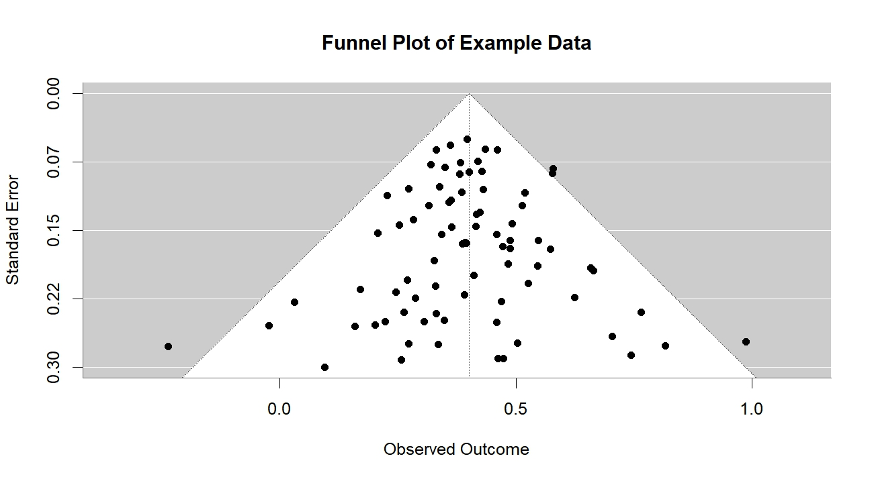
Funnel Plots
From example data, synthesised to be relatively symmetrical

Slide 78
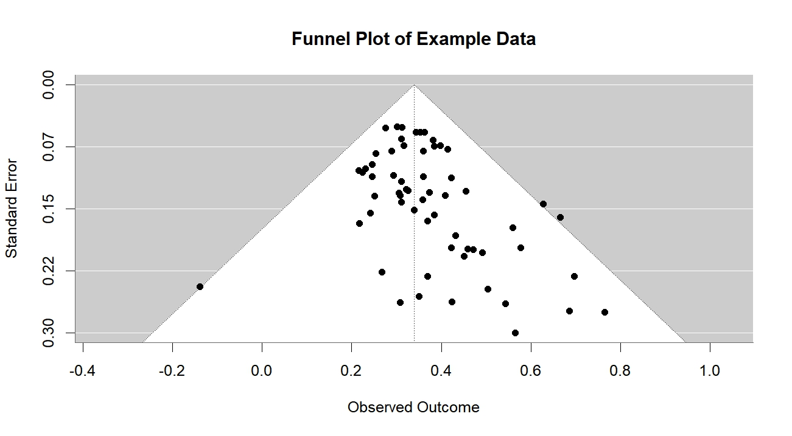
Funnel Plots
From example data, synthesised to be less likely to be published if non-significant

Slide 79
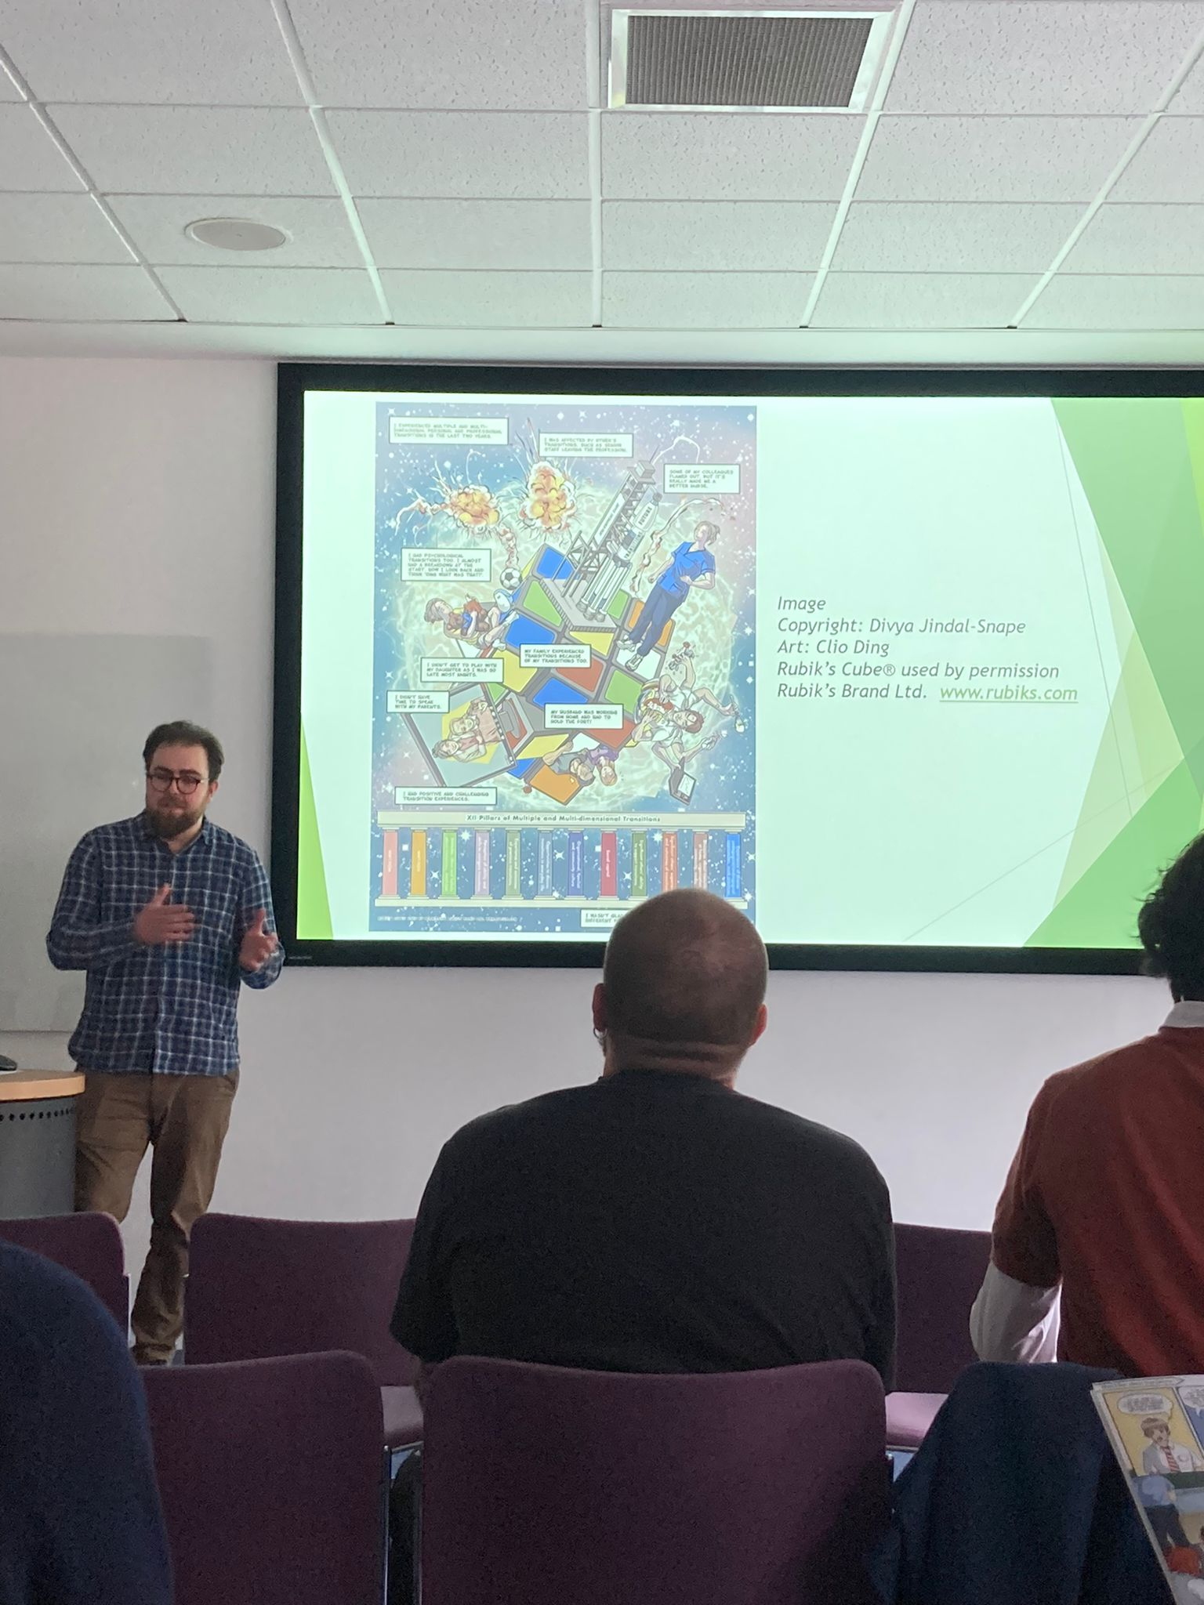
Dissemination
So you’ve done the work, now what?
A paper is good – use PRISMA report guidelines
So are conferences!
But should consider how best to reach the target audience
E.g. Infographics or comics
Be creative!
And always be transparent
Involve those that are the subject of your review
You could get their feedback

Slide 80
Any final questions?

Slide 81
Thank You!
One more thing:
A list of useful resources is available on the website: https://calummacgillivray.github.io/Training/
And here’s a handy resource from my time working in open research:
Unpaywall, a browser extension for easily getting legal open access when available: https://unpaywall.org
It makes a little green padlock appear when an open access file is legally accessible in a repository somewhere

Slide 82
Feel free to get in touch:
c.y.macgillivray@dundee.ac.uk

